Slide 1

Retail Customer Churn
Analyzing Customer Activity data WITH MRS / HDInsight/ Hive / Spark / POWERBI

Slide 2
Retail Customer Churn
Help data scientists easily build and deploy a retail customer churn prediction solution.
Customer Churn typically handled as a binary classification problem.
Class population is severely unbalanced, high volume of transaction.
When customer churn happens, business typically takes actions to retain customer, promote and motivate customer returns to keep business stronger.

Slide 3
Goals
Build an end-to-end, cloud solution for Retail Customer Churn using Microsoft R Server, Azure HDInsight with R on Linux, Azure Machine Learning, Spark, Scala, Hive, PowerBI desktop and online etc.
The demo attempts to simulate the real-world use case of data placement/storage, feature engineering, model retraining, prediction, and visualization.

Slide 4
Retail Customer Churn using HDInsight/Spark/MRS/AML Demo Architecture
Data Sources
Ingest
Prepare
(normalize, clean, feature engineering, etc)
Analyze
(build model, ML, etc)
Publish
(for prog. consumption,
for BI/visualization)
Consume
HDInsight with R + Spark
HDInsight with R + Spark
HDInsight with R + Spark
Joseph Mart For individual account
Upload Sample Data
Azure Blob Storage
Partitioning using Hive
Published AML Webservice
Azure Blob Storage
Deploy Lookup WebService using MRS
Sample Data
Reference Data
Feature engineering on Train Data using Spark App
Power BI Online dashboard via Spark
Training Model using MRS
Azure Blob Storage
Feature Engineering on Transaction data using Spark App)
Power BI Desktop dashboard
Azure Blob Storage
Azure Blob Storage
Scoring using MRS
dashboard of predictions
Azure Blob Storage

Slide 5

Shopping Activity Data
Activities.csv
Data fields | Description
TransactionId | Unique transaction ID
TransactionTime | Time when transaction occurred. Typically in the time zone of the processing end.
UserId | Unique account ID
ItemId | Item ID customer purchased
Quantity | Quantity of the items customer purchased
Value | Price of the item
Location | Where the purchase occurred
ProductCategory | Product category
Source: Cortana Analytics Retail-Customer-Churn-Prediction-Template-1

Slide 6
Customer Demographic Data
Users.csv
Data fields | Description
UserId | Unique account ID
Age | Customer age
Address | Customer address
Gender | Customer gender
UserType | Customer type
Source: Cortana Analytics Retail-Customer-Churn-Prediction-Template-1

Slide 7
Feature Engineering
Non-Churn (having at least 1 transaction in the last 21 days)
Pre-churn Period
21 days
Churn (no transaction in the last 21 days)
Latest Transaction for All Customers
Features:
Age;
Address;
StDevQuantity;
StDevValue;
AvgTimeDelta;
Recency;
TotalQuantity;
UniqueTransactionId;
UniqueItemId;
UniqueLocation;
UniqueProductCategor;
TotalQuantityperUniqueTransactionId;
TotalQuantityperUniqueItemId;
TotalQuantityperUniqueLocation;
TotalQuantityperUniqueProductCategory;
TotalValueperUniqueTransactionId;
TotalValueperUniqueItemId;
TotalValueperUniqueLocation;
TotalValueperUniqueProductCategory

Slide 8




Prepare and partition the data closely into real-world use case by HIVE
Prepare and partition Data:
In Parallel, Cloud
Simulate data placement in the real-world use case
Parallelize distributable Hadoop
Operationlize:
Easy SQL-wise
Parallel Algorithm
Results
HDInsight Execution:
Hive
Remote Execution
Parallelized Compute
Remote Execution
Context
Iterate/ Sequence
Chunk
Move BIG Work to the Data
Chunk
Parallel
Worker Tasks
Chunk
Large Data Sets in Chunks

Slide 9

Feature engineering the data in Spark
Feature Engineering and Tag:
In Parallel, Cloud
On top of Hadoop
In Memory Processing
Faster batch processing than MapReduce
Developed in Scala, Parallelized Distributed Systems
Better do feature engineering in Spark, not in MRS
Operationlize:
Spark Application
Parallel Algorithm
Results
HDInsight Execution:
Remote Execution
Scala
Parallelized Compute
Remote Execution
Context
Iterate/ Sequence
Chunk
Move BIG Work to the Data
Chunk
Parallel
Worker Tasks
Chunk
Large Data Sets in Chunks

Slide 10
Run Parallel Algorithms from MRS
Explore and Model:
In Parallel, Cloud
Rx command
Parallelize distributable MRS
Operationlize:
Train/Score In Parallel
Parallel Algorithm
Results
HDInsight Execution:
Rx command
Remote Execution
Parallelized Compute
Remote Execution
Context
Iterate/ Sequence
Chunk
Move BIG Work to the Data
Chunk
Parallel
Worker Tasks
Chunk
Large Data Sets in Chunks

Slide 11

Run R in HDInsight with Spark ComputeContext
Move the Work to the Data
+ Spark
HDInsight Execution of RevoScaleR
HDInsight Execution of:
RevoScaleR
Retrieve Models, Scores, Transformed Data
Operationalise scoring/prediction in HDInsight for data batches

Slide 12

Deploy AML Web Service in MRS
+ AzureML
HDInsight Execution of AzureML
HDInsight Execution of:
CRAN Package: AzureML
Azure Machine Learning

Slide 13
Prerequsites for Demo
Azure Subscription
PowerBI Online account and PowerBI Desktop
HDInsight Cluster on Linux with R Server
Azure Machine Learning Workspace
Windows side requirement
SSH Client
WinScp
Visual Studio with Azure SDK

Slide 14

Steps in Demo
Prepare Data
Train/Predict
Deploy

Slide 15
Prepare Data:
Tags:
Non Churn – UserID is not churn
Churn – UserID is churn
1: Upload Data in HDFS
Input:
Customer Shopping Activity Activities.csv
Customer demographic Data Users.csv
3: Partition Data in HIVE
Input:
ActivitiesSample
Partitioned table Activities with Blob
4: Feature Engineering in SPARK
Input:
Partitioned table Activities with Blob
Output:
Traindata_user_Featured in hive and blob
UsersSample
Output:
Output:
UsersSample
Partitioned table Users with Blob
2: Create Tables in HIVE
Input:
Customer Shopping Activity Activities.csv
Customer demographic Data Users.csv
Output:
ActivitiesSample
UsersSample
Partitioned table Users with Blob
Scoredata_user_featured n hive and blob
4: Tag for train data in SPARK
Input:
Partitioned table Activities with Blob
Partitioned table Users with Blob
Output:
Traindata_user_Featured in hive and blob
ActivitiesSample
Notes:
We call this “pre fraud” because once an account has been flagged as fraud it will be blocked from further transactions. Thus the transaction must have occurred prior to the identification of this accountID.

Slide 16
Model in MRS
5: Model Training
Input:
Tagged and Featured train data in blob
trainedmodel: stores a serialized model in Blob
6: Prediction
Input:
trainedmodel
Scoredata_user_featured in Hive and data in blob
Output:
churnpredictR in Hive and data in blob
Output:
Model: Decision Tree

Slide 17
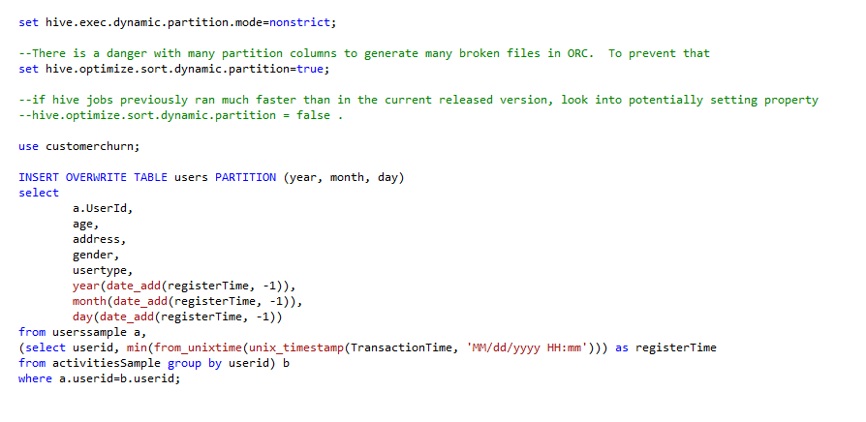

Develop in HIVE

Slide 18
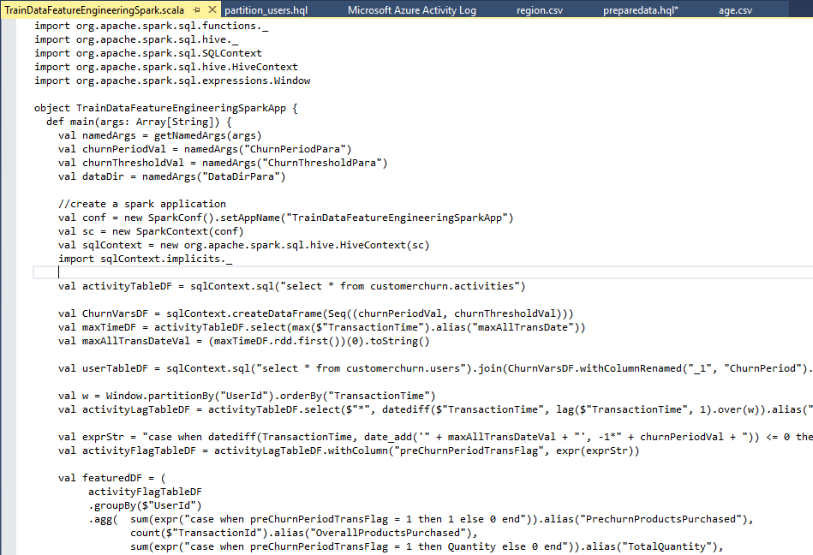

Develop in Spark

Slide 19
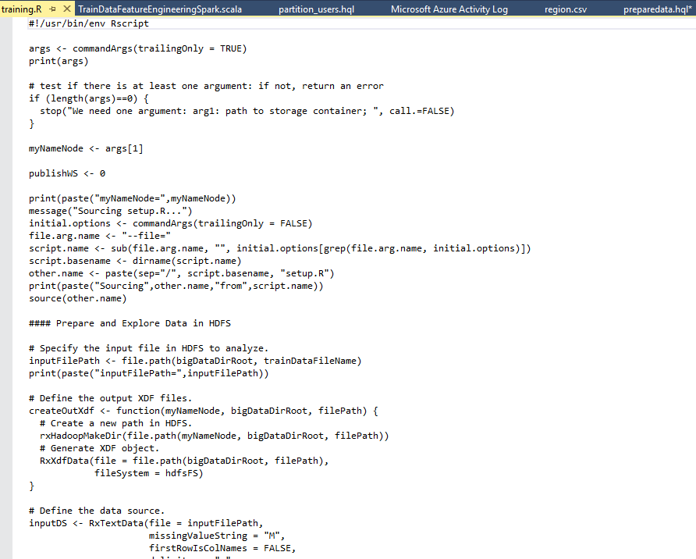

Develop in MRS

Slide 20
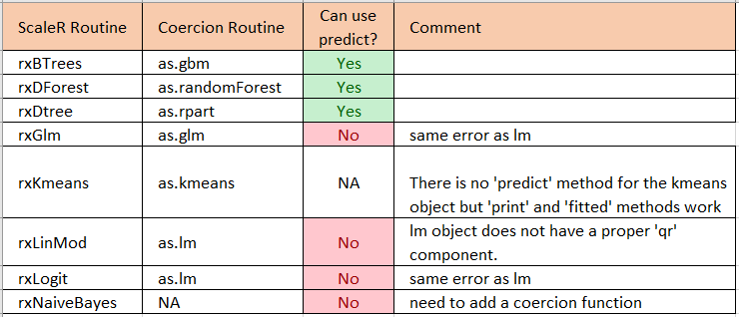
Deploy AzureML Web Service in MRS
library(“AzureML”)
RevoScaleR provides a set of coercion methods to convert a RevoScaleR model object to a standard R model object: as.lm, as.glm, as.rpart, and as.kmeans. (more information see page 193 on RevoScaleR_Users_Guide.pdf)

Slide 21
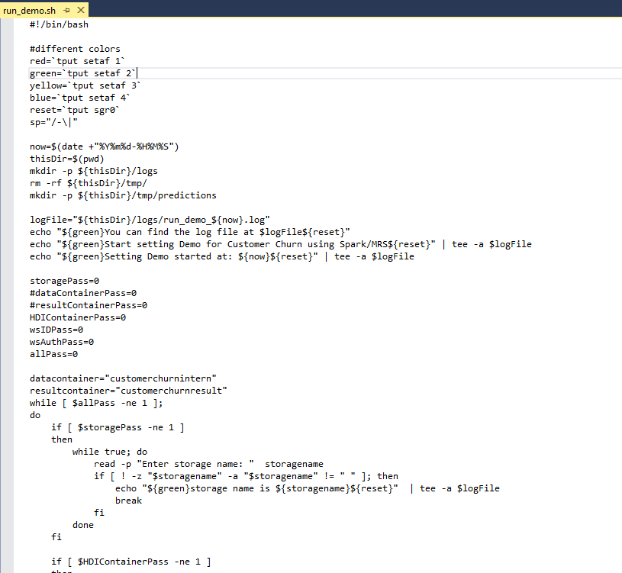

Operationalize with one-command In HDInsight

Slide 22
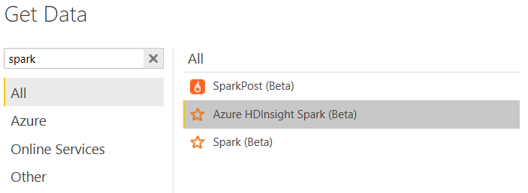
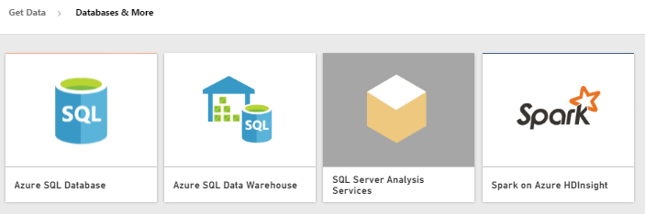

PowerBI to Spark
Desktop:
Online:
Connect directly to your Spark cluster
Does not require a data model
Interactive exploration of data
Automatically refreshes the visuals without requiring a scheduled refresh.

Slide 23
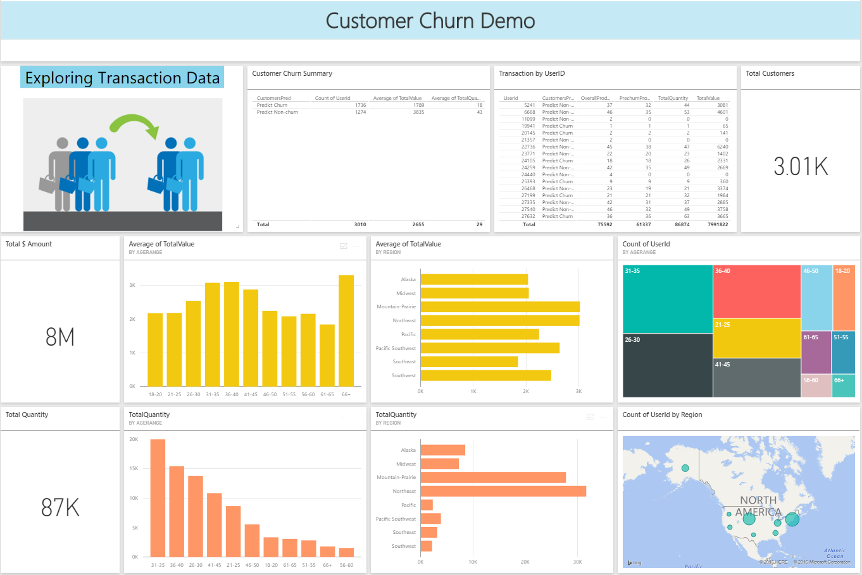
Visualize Data
Power BI

Slide 24
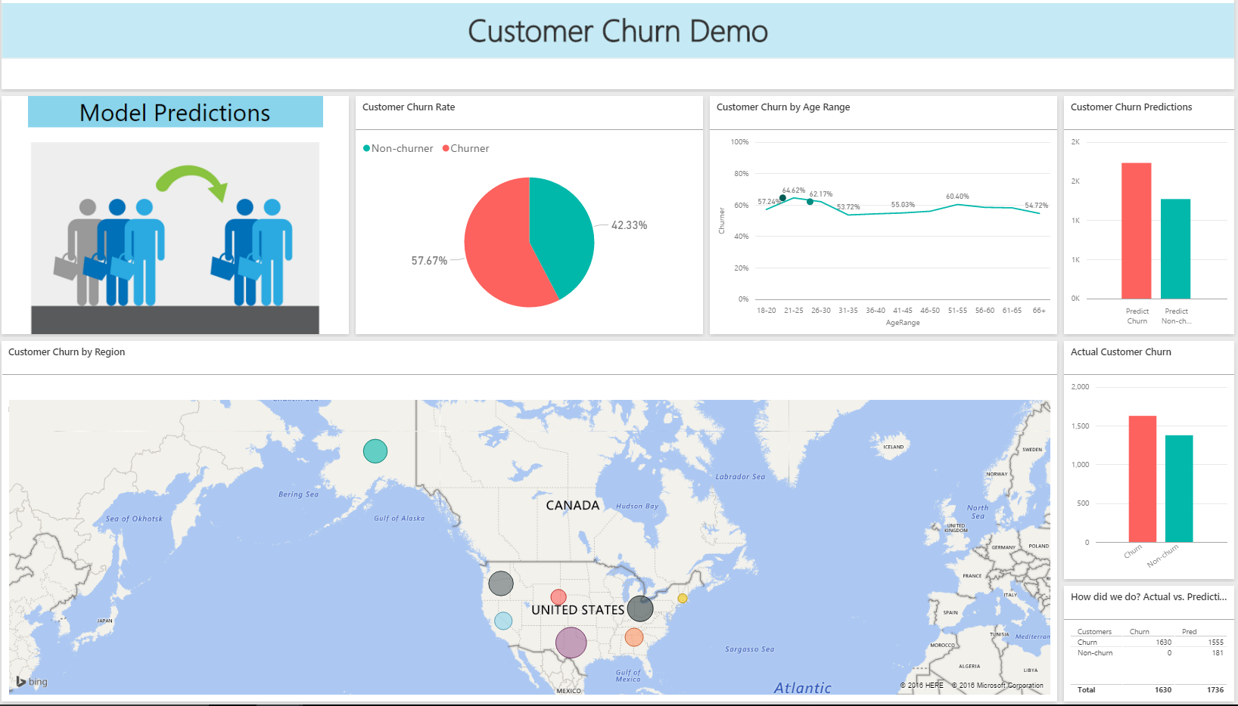
Visualize Predictions
Power BI

